Slide 1
Recognition
Visual Words

Slide 2
Word Recognition
How exactly do you recognize the words on this slide?
How do you know what they are?
What they mean?

Slide 3
The Magic Moment
Balota – the time between word recognition and accessing word meaning
How quick do you think the magic moment is?

Slide 4
Basic Methods
Ways we study word recognition:
Brain imaging
Eye Movements
Naming
Lexical Decision Task
Categorization times
T-Scope Identification

Slide 5
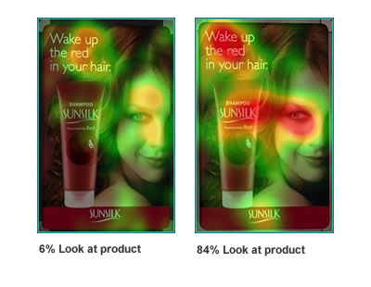
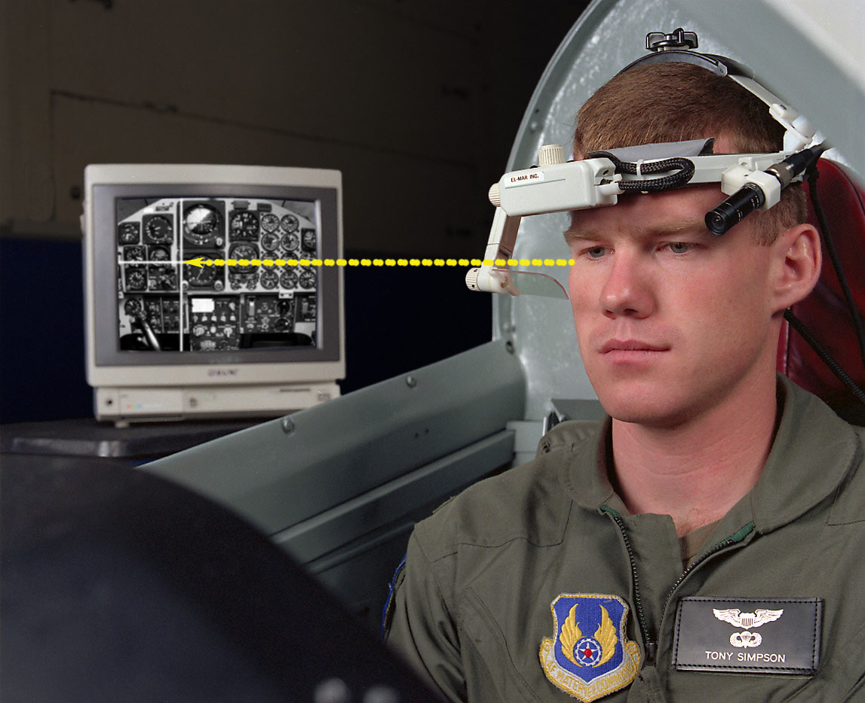

Slide 6
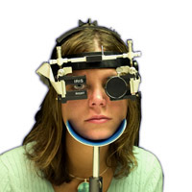
Eye Tracking
Limbus tracking – infra red beam is bounced off the white of the eye (limbus) – this procedure is good at horizontal movements, but not vertical

Slide 7
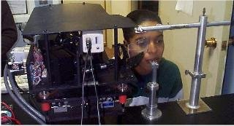
Eye Tracking
Purkinje system – uses the reflection of the cornea and lens to calculate what you are looking at – good at vertical and horizontal

Slide 8
Eye Measurements
Saccades – fast movements of the eye, forward and backward jumps
20-60 msec each
Regressions – when we move our eye backwards in a text
Mistake in reading or when text is ambiguous

Slide 9
Eye Measurements
Fixation – the still period between jumps
200-250 msec
Information taken in a fixation is about 15 characters to the right, 3-4 to the left
Span is based on reading skill

Slide 10
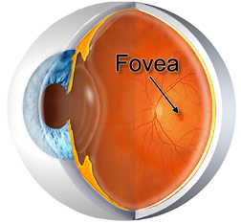
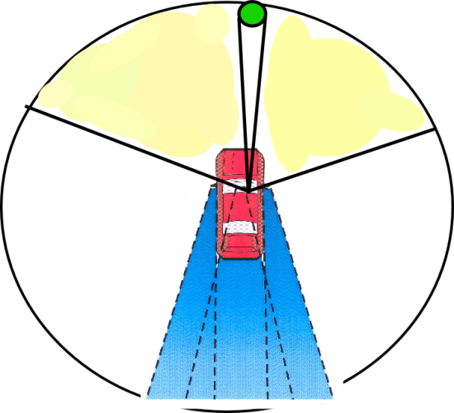
Eye Measurements
Fovea – periscope of sharp vision
2 degrees of visual angle, about 7 characters of average size text.
Periphery – outside of fovea
About 5 degrees of visual angle
Acuity is worse

Slide 11
Eye Measurements
First fixation duration – amount of time the eye spends looking at the first fixation
Total gaze time – which might include time you went back to the first fixation

Slide 12
Eye Measurements
Model created using eye tracking/movement information about visual word recognition:
EZ Reader Model – attention, visual processing, oculomotor control all together determine when and where eyes move to

Slide 13
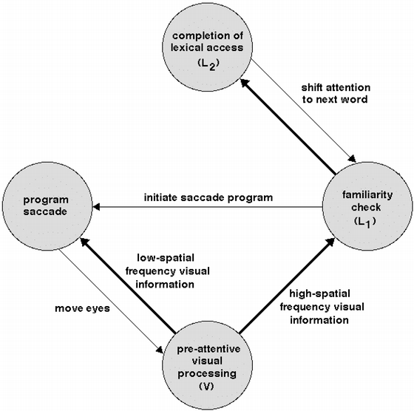
Eye Measurements
EZ Reader Model
Look at one point
Visual attention scans until acuity is bad
Saccade to make acuity better

Slide 14
Eye Measurements
EZ Reader
Visual attention is serial, checking one word at a time with a familiarity check
After the familiarity check, saccades occur
Familiarity check also pulls up word meaning, which is integrated into the linguistic structure
If this process turns out to be incorrect, we will regress back to the incorrect word

Slide 15
Response Times
We use response times as our dependent variable for several different word recognition tasks
Naming
Lexical Decision Tasks
T-Scope Identification
Categorization Tasks

Slide 16
Response Times
Naming task – shown a word, they say it out loud (name it), and the time it takes them to start to pronounce the word is measured.
Average naming latency is around 500msec
English Lexicon Project
http://elexicon.wustl.edu/

Slide 17
Response Times
Lexical decision task – person must decide if a string of letters is a word or nonword
DOCTOR = yes word
WERM = no not a word
Also measure error rates on this task

Slide 18
Response Times
Problem: speed accuracy trade off – the faster you go the more errors you make, which is why you analyze both
Response time averages are from 500 msec to 1 sec – depends on many factors
What would influence your decision on if something is a word or not?

Slide 19
Response Times
Priming – presenting material before the word to which a response has to be made
Lexical Decision/Naming Tasks
DOCTOR
NURSE
TREE

Slide 20
Response Times
SOA – stimulus onset asynchrony – the time between the prime and the target
You get stronger priming for long SOAs and less for short SOAs.

Slide 21
Response Times
Semantic categorization task – asks a participant to do something with the meaning of the word
Is an apple a fruit or a vegetable?
Is an apple smaller or larger than a chair?

Slide 22
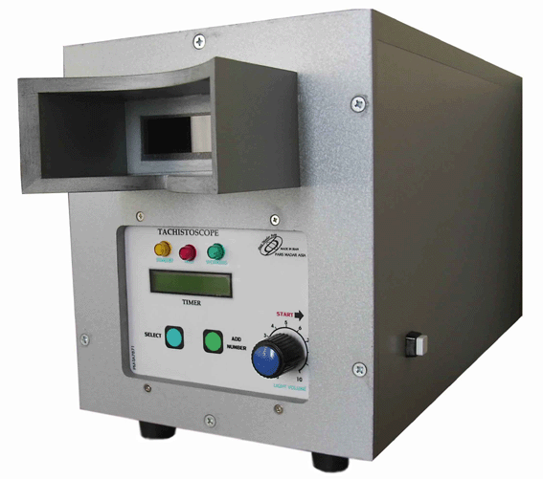
Response Times
Tachistoscope – a machine used to present words for extremely short durations
Used before computers were around or could be programmed to do this accurately

Slide 23
Response Times
T-scope identification – show words for a short time and find the critical point in which people can no longer identify words (threshold)
Subliminal perception – your perception of words is affected even though you don’t know you saw anything (priming)

Slide 24
Word Recognition
Things that change word recognition times:
Degrading, masking
Frequency, familiarity, age of acquisition
Length, neighborhood
Priming, attention

Slide 25
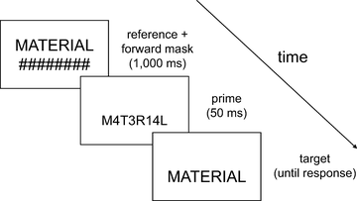
Interference
Stimulus degradation – making them harder to read, harder to recognize, breaking up/masking the letters

Slide 26
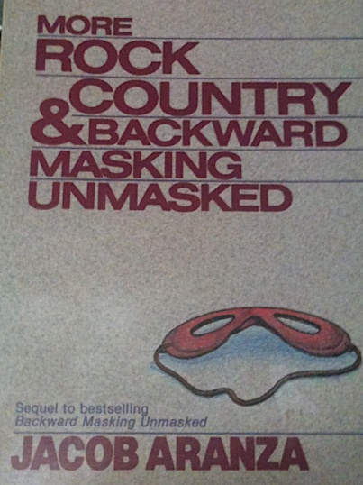
Interference
Backwards masking – presenting another stimulus immediately after the target
Energy masking – putting a mask after the stimulus that is unstructured (noise masking), like random TV fuzz
Interferes with feature identification because there are new features which overwrite the old ones

Slide 27

Interference
DOCTOR

Slide 28
Interference
Backwards Masking
Pattern masking – structured mask, like other letters
Interferes at the letter level because there are new letters to process

Slide 29
Interference
DOCTOR
C ARROT

Slide 30
Interference
Partial word masking – when you present a word and delay showing people some of the letters
Hurts you more when you delay consonants than vowels
Notes:
probably due to the visual to sound mapping – vowels change depending on the consonant, but consonants are more constant, which helps you figure out the word).

Slide 31
Interference
S A E
STATE

Slide 32
Facilitation
Frequency – common words are easier to recognize
Frequency norms
Google (https://books.google.com/ngrams)
Kucera and Francis (Brown Corpus)
CELEX
HAL
SUBTLEX**
Facebook?!

Slide 33
Facilitation
What do you think are the most common words in the English Language?
http://www.sporcle.com/games/common_english_words.php

Slide 34
Facilitation
 | Brown Corpus | HAL | Facebook
1 | a | the | I
2 | in | to | you
3 | he | of | to
4 | be | and | the
5 | I | a | a
6 | have | in | and
7 | one | is | is
8 | there | that | it
9 | who | you | in
10 | will | for | my

Slide 35
Facilitation
Frequency
Not always the best indicator, word norms change over time
People will rate words as more frequent even if they are the same
Giggle > Cohere
Interacts with expertise with words

Slide 36
Facilitation
Age of acquisition – age at which you first learned a word
GIANT, learned early, but low frequency
Words you learn early are faster than later learned words

Slide 37
Facilitation
Age of acquisition
Problem: cumulative frequency – how often we’ve heard the world over our lifetime
Brain modeling: as we grow older, our brains are less plastic
Early learned words have stronger representations (activations)
Later learned words, even with the same frequency, have smaller activations

Slide 38
Facilitation
Word length … but how do you measure word length?
Letters?
Syllables
Length of naming time

Slide 39
Facilitation
Number of letters doesn’t seem to have an effect on word recognition time
As long as they are in the buffer of visual recognition (5 to 12 characters so you don’t have to make a saccade)

Slide 40
Facilitation
It does take you longer to name words that have more syllables
Probably because of the prep time to pronounce those different sounds
Moving your mouth, remembering how to form the sound

Slide 41
Facilitation
Neighborhood effects
Orthographic neighbors – words that look the same as the target word. Sometimes defined as the number of words you can create from changing one letter in the word
N is the neighborhood size or density
Words with more neighbors are easier to recognize

Slide 42
Facilitation
Orthographic Neighborhood
Which would be faster?
Game?
Cave?

Slide 43
Facilitation
Word-nonword differences
Words are faster than nonwords (a string of letters that does not form a word)
Pseudo words – nonwords that are pronounceable
We are much faster at rejecting non plausible words (TNVK) than we are pseudowords (TINK)

Slide 44
Facilitation
Priming
Repetition
Form Based/Orthographic
Semantic

Slide 45
Facilitation
Repetition priming – priming by repeating a stimulus
We are much better at recognizing words when they have been repeated
Frequency attenuation – repetition priming helps more for low frequency words than high frequency words

Slide 46
Facilitation
Form based priming – also called orthographic priming – facilitation at recognizing words when they look the same
Semantic priming – facilitation when words are related in meaning

Slide 47
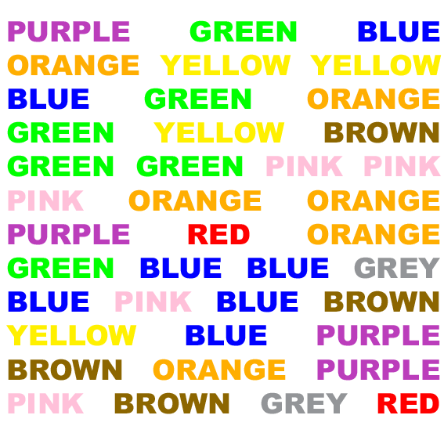
Facilitation
Attention
Reading is an automatic process – see the stroop task

Slide 48
Facilitation
Attention
Automatic processes – processing that is unconscious, fast, obligatory, facilitatory, does not involve working memory space, does not have dual task problems
Attentional/controlled processes – processing that requires central resources, requires working memory space, accessible to consciousness

Slide 49
Facilitation
If reading is automatic can it also be controlled?
Priming studies show that at short SOAs you get fast automatic priming, long SOAs you get controlled priming, both which help.
Predictive validity and proportion effect – the more related cue-target pairs you use, the more priming you get and vice versa
We basically have early automatic processes and slower later controlled processes that make up priming

Slide 50
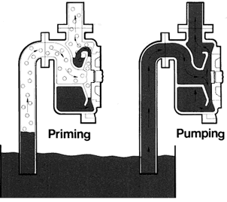
Facilitation
Note – this section is out of order with the textbook (labeled meaning based facilitation of word recognition)…to me it makes more sense to put these two sections together.
Going back to priming now that we’ve defined automatic and controlled processes…

Slide 51
Facilitation
Types of Semantic Priming
Associative priming – association is when two word are related by context and word use
ROCK and ROLL
Databases: Nelson et al. 2004, free association task, Small World of Words

Slide 52
Facilitation
Types of Semantic Priming
Nonassociative semantic priming – words that are only related by meaning or feature overlap
PATROL and GUARD
Databases: McRae et al. 2005, Maki et al. 2004, Vinson and Vigliocco 2009, Buchanan et al., 2013/2016 feature production task

Slide 53
Facilitation
Most research has mixed the two together, just saying that they are studying semantic priming (Hutchison, 2003)
When you separate the two out, you get strong associative priming
Associations are probably automatic, semantics are controlled higher order processes

Slide 54
Facilitation
Sentence context and semantics
Priming from context is the extra bump over the association of the words
You should brush your teeth every single ____.
Day is faster than year or hour.

Slide 55
Facilitation
Sentence context and semantics
You get priming (or facilitation) for highly predictable words (more frequent)
More than words that would fit but are not predictable
Especially over words that don’t make sense.
The janitor cleaned the floor with the ____ (mop, solvent, lawnmower).

Slide 56
Facilitation
Sentence context and semantics
Controlled process – generating expected words
ERP:
Results suggest that priming and context worked at the same time
N400 attenuation that varied based on the amount of association and sentence context

Slide 57
Facilitation
Sentence context and semantics
Controlled processes: checking items to make sure they are right ones, expectancies, integrating word into larger context
Automatic processes: associative priming

Slide 58
Facilitation
Other factors:
Grammatical category (mad libs)
Imagine ability
Meaningfulness
Concreteness

Slide 59
If you have to ask about task…
Different tasks, different results
Lexical decision
Naming
Frequency

Slide 60
If you have to ask about task…
Lexical Decision Tasks
Does this only measure automatic activation of word information?
Post Access effects – also measures participant’s decision making and strategies

Slide 61
If you have to ask about task…
Lexical Decision Tasks
Expectancy generation – we are unconsciously thinking of what word would appear next
Post lexical checking – checking if target matches or is related to the first cue word

Slide 62
If you have to ask about task…
Naming – seems to measure only automatic processes
Mediated priming – priming through a third party (lion – stripes – mediated by tiger)
You do not see this effect in LDT because of controlled processing

Slide 63
If you have to ask about task…
Frequency effects – are they automatic or controlled?
Experiment: Participants were trained on a frequency distribution of fake words.
They were shown blurred symbols and produced the same frequency distributions of guesses as the fake words

Slide 64
If you have to ask about task…
Frequency effects
Frequency seems to create a response bias or helps with guessing
Frequent words need less evidence to be identified
Repeated exposure lowers recognition threshold
Not related to practice, but overall frequency
Hierarchical example

Slide 65
If you have to ask about task…
Lexical Decision
Naming
Sensitive to frequency effects because of controlled processes
Frequency of orthographic neighbor (blue and blur) hurts you
Only see frequency effects with regular words
Otherwise you have to look up the sound to spelling rules with irregular words (slows down)
Frequency of orthographic neighbor helps you

Slide 66
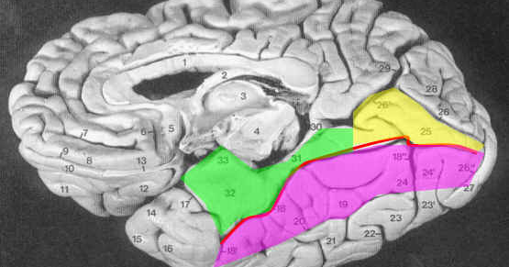
Brainz

Slide 67
Brainz
Is word processing a separate thing?
Fusiform gyrus (left visual cortex) seems to respond to words and pseudowords
Even when you change the visual features of the word (cAsE)

Slide 68
Brainz
Visual recognition parts
Holistic Processing – used especially for faces, looking at the whole object as one thing instead of the features
Processing of complex multiple parts – like words

Slide 69
Brainz
Agnosia – disorder of object recognition – should always have one of these two parts
Prosopagnosia – can’t recognize faces
Dyslexia – can’t recognize words

Slide 70
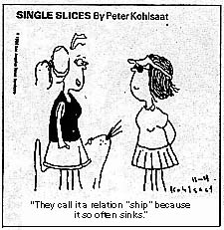
Morphology
Processing complex words

Slide 71
Storage Hypotheses for Morphology
Full listing hypothesis – all entries for all versions of words (kiss, kisses, kissing)
Does that seem excessive to you?

Slide 72
Storage Hypothesis for Morphology
Obligatory decomposition hypothesis – listing the stem of the word with the rules on how to change them to different versions
Also store a set of exceptions
Affix stripping – to recognize a complex word, we must strip it down

Slide 73
Storage Hypothesis for Morphology
Dual pathway hypothesis – half way between the first two, we wouldn’t list all the different versions just a lot of the common ones for a short cut

Slide 74
Storage Hypothesis for Morphology
Research:
In LDT, words with affixes (or look they like have affixes – results) take longer to recognize
As if we are stripping them down to the base word
Homophones – sound the same
If you are asked if a word with an affix has a homophone, you have a hard time coming up with an answer
Fined – find: trouble because it’s stored fine and -ed

Slide 75
Storage Hypothesis for Morphology
Research:
Words are recognized faster if the stem (without affixes) is more frequent (seeming, mending)
Some support for dual pathway because of weird compound words – like buttercup
It’s meaning is different than it’s separate parts, so it’s not primed by milk or spoon

Slide 76
Storage Hypothesis for Morphology
However, it doesn’t necessarily seem to be all about affixes
Transparency – we seem to decompose semantically transparent words and leave opaque words together
Supports dual pathway

Slide 77
Storage Hypothesis for Morphology
Phonologically transparent – if shared part of words sound the same
Friend and friendly, sign and signal
Semantically transparent – meaning is obvious from its parts
Happiness is predictable with unhappiness
Depart and department – semantically opaque

Slide 78
Models of Word Recognition
Four questions models have to cover:
Automatic or interactive processing
Serial or parallel processing
Activation – how does it spread?
How do we find items?

Slide 79
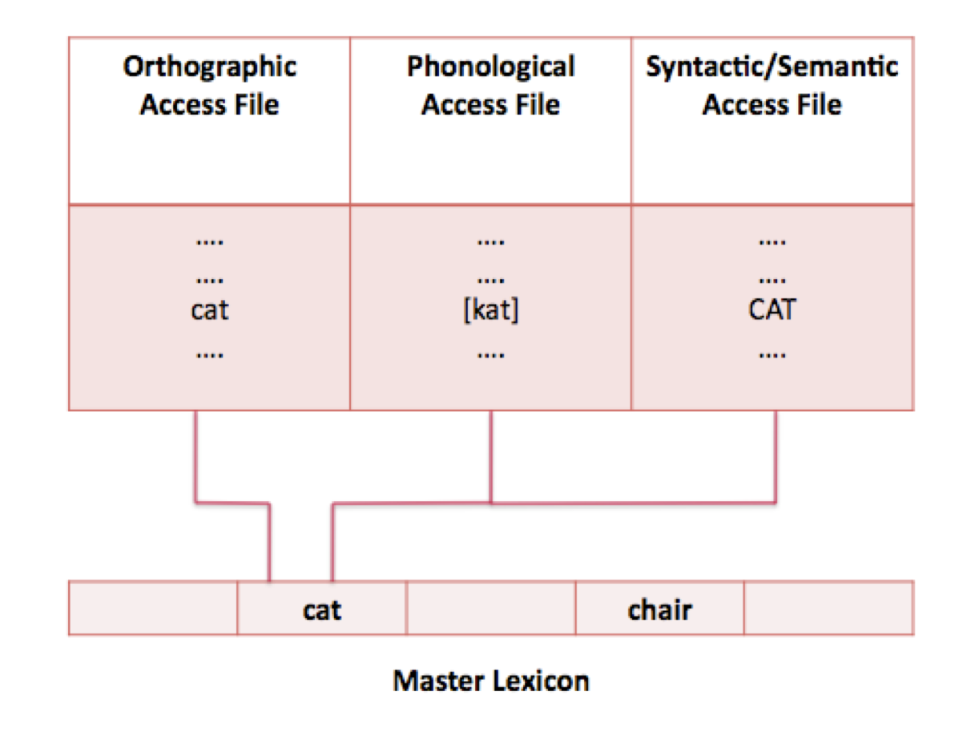
Models of Word Recognition
Forster’s Autonomous Serial Search Model
Page 194

Slide 80
Models of Word Recognition
Forster’s Autonomous Serial Search Model
Model is similar to searching a dictionary
Words are ordered (alphabetical)
When you get to the word – meaning, phonology, etc. is stored.

Slide 81
Models of Word Recognition
Forster’s Autonomous Serial Search Model
Stages of model
Perceptual processes
Identify words by using a serial search through the lexicon (access file)
Files are modality specific (orthographic, phonological, syntactic-semantic)
Master file includes the meaning of the word

Slide 82
Models of Word Recognition
Forster’s Autonomous Serial Search Model
Bins – used to speed up system
Access files are stored in separate bins based on syllable or first few letters
Within bins items are stored by frequency

Slide 83
Models of Word Recognition
Forster’s Autonomous Serial Search Model
Literature Support
Frequency causes priming
Search is autonomous
Repetition priming occurs by changing bin frequency

Slide 84
Models of Word Recognition
Forster’s Autonomous Serial Search Model
Literature Support
Illegal words are easy to reject because they don’t match bins
Pseudowords take forever because you have to search each bin

Slide 85
Models of Word Recognition
Forster’s Autonomous Serial Search Model
Literature Support
Rank hypothesis – relative frequency of word is much more important when it comes to how fast you will find the word
Notes:
This model accounts for that by bin separation – one bin has frequency of 100,000 and 10, while the second bin is 20 and 10. Both the 100,000 and 20 have the same relative frequency and should be primed the same (and are).

Slide 86
Models of Word Recognition
Forster’s Autonomous Serial Search Model
Word recognition is very fast, how could it possibly be serial?
How do we learn to pronounce nonwords?
Forster added that the processing is parallel, so that all bins are searched at the same time – makes the whole system faster
Notes:
This model accounts for that by bin separation – one bin has frequency of 100,000 and 10, while the second bin is 20 and 10. Both the 100,000 and 20 have the same relative frequency and should be primed the same (and are).

Slide 87
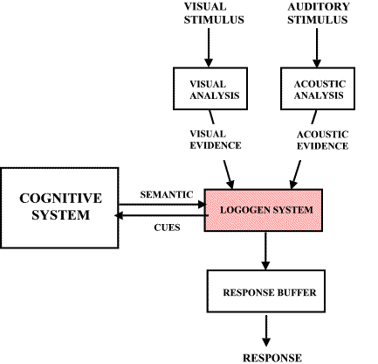
Models of Word Recognition
Logogen Model – Morton
Page 195

Slide 88
Models of Word Recognition
Logogen Model – Morton
Logogen – simple feature counter for every word, as the features accumulate it adds up until the threshold is reached and the word is recognized
Lexical access is direct – some simultaneously and some parallel

Slide 89
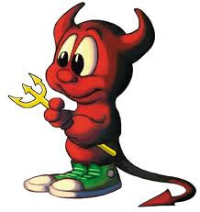
Models of Word Recognition
Logogen Model – Morton
Features and demons
Demons monitor perceptual input for particular features
The more evidence there is for a feature, the louder the demon shouts

Slide 90
Models of Word Recognition
Logogen Model – Morton
Each logogen has a resting activation
As evidence is presented it raises activation – so if you are shown a letter t, all the words with t will activate
Similar to action potentials, once the threshold is reached, the logogen will fire and a word will be recognized

Slide 91
Models of Word Recognition
Logogen Model – Morton
This model does not distinguish between context and perceptual information, so they both help in recognition
More frequent items have lower thresholds
Nonwords will be rejected if no logogen has fired after a certain time period has passed

Slide 92
Models of Word Recognition
Logogen Model – Morton
Problems
The original model had the same logogen for all modalities, but that suggests priming should be equal for all forms (it’s not).
Solution is to create four logogen systems – reading, writing, listening, speaking
Notes:
The problem with that is that the model predicts that all modalities would give you equal priming
Many experiments show that modalities are best if matched (visual-visual) with priming
The new model included separate logogens for input and output
Seems that the output of the priming doesn’t matter as much as the input of the priming

Slide 93
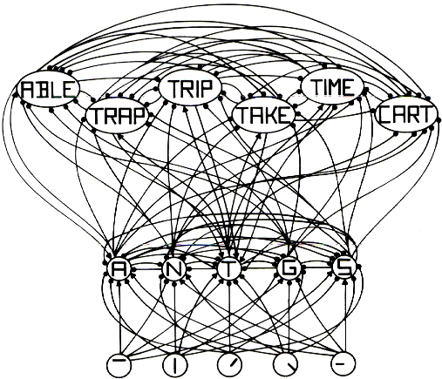
Models of Word Recognition
Interactive Activation – McClelland/Rumelhart

Slide 94

Models of Word Recognition
Interactive Activation – McClelland/Rumelhart
Model was originally designed to investigate the word superiority effect

Slide 95
Models of Word Recognition
Interactive Activation – McClelland/Rumelhart
Parts
Input level of visual feature units
Letter level
Output level of word units
Connections are excitatory or inhibitory
Each unit is connected to each other at the same level – creating competition for activation

Slide 96
Models of Word Recognition
Interactive Activation – McClelland/Rumelhart
Process
When a unit is activated -> sends activation in parallel to everything it’s connected to.
This will increase activation in some, decrease others
Units that get an increase will start to decrease connections on the same level
Activation also flows back down…making words easier to see

Slide 97
Models of Word Recognition
Hybrid Models – Becker
Combine both the connectionist/logogen models and serial search models

Slide 98
Models of Word Recognition
Hybrid Models – Becker
Sensory set or perceptual processes that generate stimuli
Semantic set or context top down processes that generate stimuli (ordered by frequency)
These two are checked and verified against the data
Verification is serial
If no match is found, then you go to the sensory set

Slide 99
Lexical Ambiguity

Slide 100
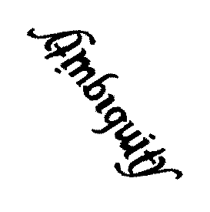
Lexical Ambiguity
Types of ambiguity
Homophones – words that sound the same (bank, pen)
Heterographic homophones – words with different spellings that sound the same (knight, night, soul, sole)

Slide 101
Lexical Ambiguity
Types of ambiguity
Homographs – words that look the same but are pronounced differently (lead metal, lead to the store)
Polysemous words – words with multiple meanings (bank, straw, ball, letter)

Slide 102
Lexical Ambiguity
Types of Ambiguity
Polysemous words
Multiple meanings – words have completely unrelated meanings
Multiple senses – word have related meanings – twist (coil, turning, sprain an ankle, distort the meaning)

Slide 103
Lexical Ambiguity
Models
Context guided single reading lexical access model – context restricts the access process so that only relevant meanings can be processed

Slide 104
Lexical Ambiguity
Models
Ordered access – all the senses of a word are activated in frequency order (pen is a writing utensil versus animal holder)
These are then checked against context

Slide 105
Lexical Ambiguity
Models
Multiple access model – all senses are activated and appropriate one is chosen when context permits

Slide 106
Lexical Ambiguity
Experiments!
Exp 1: Participants were shown:
After taking the right turn at the intersection, I…
After taking the left turn at the intersection, I…
Which do you think takes longer to fill in?
Notes:
The first sentence because there are multiple meanings for the word right…(correct right side) and seems to indicate we activate all the meanings at once.

Slide 107
Lexical Ambiguity
Experiments!
Exp 2: participants heard:
The farmer put his straw beside the machine.
The farmer put his hay beside the machine.
Which took longer to recognize?
Notes:
- The first one because straw has multiple meanings.

Slide 108
Lexical Ambiguity
Experiments!
Exp 3: Dichotic listening task
Attended: the spy put out the torch as a signal to attack.
Unattended: the spy extinguished the torch in the window.
Unattended: the spy displayed the torch in the window.
Notes:
They were asked to paraphrase the attended ear message. It was biased by which version of the unattended ear they heard.

Slide 109
Lexical Ambiguity
Experiments!
Exp 4: People are slow to find ambiguous words when they match the most frequent context.
The accountant filled his pen with ink.
The farmer put the sheep in the pen.
Notes:
Indicates that frequency interacts with activation of all meanings.

Slide 110
Lexical Ambiguity
Experiments!
Exp 5: Priming shows that selective access is occurring
Save bank money
River bank money
Day bank money
Notes:
Money is fastest with the first one – which should all be the same if all forms of bank were activated.

Slide 111
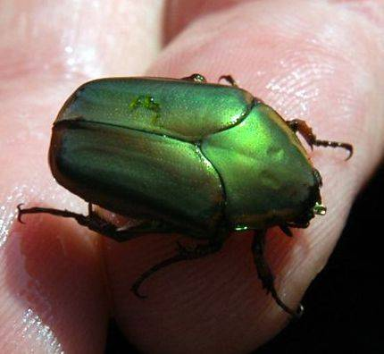
Lexical Ambiguity
Experiments!
Rumor had it that, for years, the government building had been plagued with problems. The man was not surprised when he found several (spiders, roaches, and other) bugs in the corner of the room

Slide 112
Lexical Ambiguity
Experiments!
People got a LDT after the word bugs or corner
ANT, SPY, SEW
At the word bugs, we got priming for both ANT and SPY (indicating that quickly both versions were available)
At the word corner, only got activation for the word ANT (or relevant meaning)

Slide 113
Lexical Ambiguity
Summary
When we hit an ambiguous word, we activate all meanings
Context quickly rejects the non related meanings (200msec or less)
Less frequent meanings take longer to access because they need more activation to cross threshold
Appears that sematic representation of sentence is essentially word by word

Slide 114
Lexical Ambiguity
Recent models
Selective access model – prior information constrains access so only appropriate meaning is accessed
Reordered access model – availability of the appropriate meaning is increased (more activation)

Slide 115
Lexical Ambiguity
Recent models
Autonomous access model – context has no effect, but successful integration of one meaning with ambiguous word eliminates activation and search for other meanings.

Slide 116
Lexical Ambiguity
Experiment
Having been examined by the king, the page was soon marched off to bed (positive)
Having been hurt by the bee-sting, the page was soon marched off to bed (negative)
Just as Henrietta had feared, the page was soon marched off to bed (neutral)
Reordered access wins!
Notes:
Integration model predicts that context will not help so all meanings will be activated
Therefore: page will be longer in the negative condition than positive and neutral
Later context will take longer in the positive and neutral conditions
You can’t successfully integrate in the negative condition so the search takes longer
Reordered access model predicts context will have an effect
Processing the positive condition will be quick because the non-dominant meaning of the word page will be bumped up.
The negative and neutral conditions don’t help, so they will take longer
Reordered access model wins!
Context sensitive model – meaning frequency and biasing context interact and work together.

Slide 117
Lexical Ambiguity
Summary!
Pattern of access depends on frequencies of meaning, extent of disambiguating context

